Slide 1
Training on Basic to Intermediate CCNA

Slide 2
Training outline
Layered Architecture
Ethernet networking and topologies
IP addressing and subnetting
Communication media
Cisco IOS and CLI
Layer 2 switching
VLAN, Trunking, VTP, STP
Layer 3 services
Routing, DHCP, ACL, NAT
Troubleshooting utilities
Demonstrations

Slide 3
Layered approach
Why reference model?
Communication b/n different vendors
OSI reference model
Why layered approach?
Reduces complexity: divides into smaller and simpler components
Defines functions of each layer, prevents changes in one layer from affecting other layers

Slide 4
IP Addressing
What is IP address ?
Classful IP addressing
Subnetting
Classless Inter-Domain Routing (CIDR)
Solutions to Scaling IP Address Space

Slide 5
What is IP address ?
Host 3
Application
HTTP, FTP, SMTP, TELNET, etc
Transport
TCP, UDP
Network
IP
Link
PPP, Ethernet
Physical
www.cs.umass.edu
128.119.240.46
Application
Application
Transport
Transport
Network
Network
Link
Link
Physical
Physical
Host 2
Host 1

Slide 6



Classful IP Addressing
32 bits
Dotted-Decimal Notation

Slide 7
Special Cases:
0.0.0.0: default route, used only during Startup
127.0.0.0: loopback, test TCP/IP for IPC on local machine
host all 0: this host
host all 1: limited broadcast (local net)

Slide 8
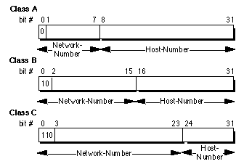
/8
2⁷-2 = 126 networks
2²⁴-2 = 16,777,214 hosts / network
/16
2¹⁴ = 16,384 networks
2¹⁶-2 = 65,534 hosts / network
/24
2²¹ = 2,097,152 networks
2⁸-2 = 254 hosts / network
Class D: (IP Multicasting)
0 4
1110
Class E: (Experimental use)
0 4
1111

Slide 9
Partition of the Classful IP Addresses
2³² = 4,294,967,296 addresses
IP Address Space
Class A
Class B
Class C
D
E
50 %
25%
12.5%
6.25%

Slide 10
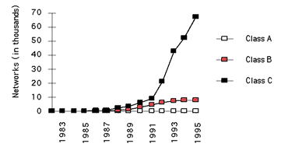
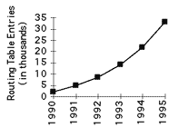
Limitations to Classful Addressing
Running out of address space soon
2³² = 4,294,967,296 addresses
Class boundaries did not foster
efficient allocation of address space
Lack of address class to support medium size company
-- Class B: 65534 hosts/network, too big!
-- Class C: 254 hosts/network, too small!
-- Use multiple class C addresses,
increase routing table!

Slide 11



Subnetting
Idea: Add one more level (subnet number) to the class hierarchy
Subnet Mask

Slide 12
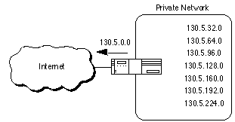
Subneting Advantages:
routing table does not grow
flexibility for local network
administrator
hide route flapping from
outside routers

Slide 13
Subnet Design Considerations
1) How many total subnets does the organization need today?
2) How many total subnets will the organization need in the
future?
3) How many hosts are there on the organization's largest subnet
today?
4) How many hosts will there be on the organization's largest
subnet in the future?

Slide 14
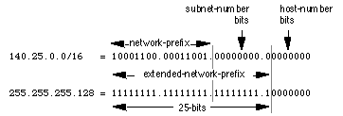
Subnet Design Example
Given : An organization has been assigned the network number
140.25.0.0/16 and it needs to create a set of subnets that
supports up to 60 hosts on each subnet.
1. Defining the Subnet Mask / Extended-Prefix Length
2⁶-2 = 62, no room for expansion; 2⁷-2 = 126

Slide 15
Subnet Design Example Cont’d
2. Defining Subnet Numbers
Base Net:10001100.00011001.00000000.00000000=140.25.0.0/16
SN#0:10001100.00011001.00000000.00000000=140.25.0.0/25
SN #1:10001100.00011001.00000000.10000000=140.25.0.128/25
……………………………………………………………………..
SN #511:10001100.00011001.11111111.10000000=140.25.255.128/25
3. Defining Hosts Addresses for Each Subnet
SN #3: 10001100.00011001.00000001.1 0000000 = 140.25.1.128/25
Host #1: 10001100.00011001.00000001.1 0000001 = 140.25.1.129/25
Host #2: 10001100.00011001.00000001.1 0000010 = 140.25.1.130/25
………………………………………………………………………….
Host #127: 10001100.00011001.00000001.1 1111110 = 140.25.1.193/25
4. Defining the Broadcast Address for Each Subnet
Subnet #3 broadcast: (all 1's host address)
10001100.00011001.00000001.1 1111111 = 140.25.1.255

Slide 16
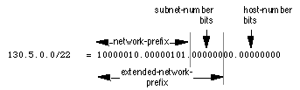

Variable Length Subnet Masks (VLSM)
Classless Inter-Domain Routing (CIDR) very similar
Allow more efficient use of network addresses
2¹⁰-2=1022 hosts/subnet, waste of addresses when host number small
2⁶-2=62 hosts/subnet, good for small subnet

Slide 17
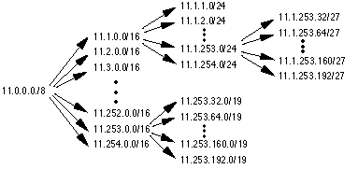
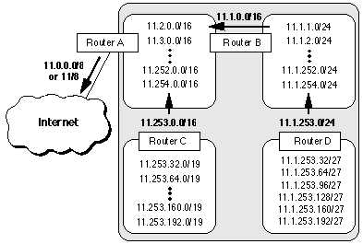
Helps to reduce routing table size (Route Aggregation)
Subnets can be further
recursively divided into
sub-2 nets and so on
A subnet summarizes all
its lower level hierarchies
into a single advertisement

Slide 18
VLSM Design Considerations
At each level, ask the following questions:
1) How many total subnets does this level need today?
2) How many total subnets will this level need in the future?
3) How many hosts are there on this level's largest subnet today?
4) How many hosts will there be on this level's largest subnet be
in the future?
e.g. 5-college

Slide 19
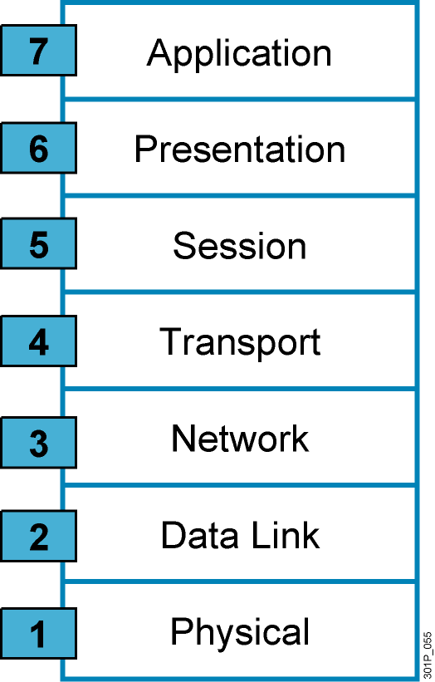
OSI and TCP/IP layers
OSI
TCP/IP
User interface to different
application layer protocols
Data translation
Compression
Code formatting
Application
Setting up, terminate
Keeps d/t data separate
End-to-end connection
Segmentation
Host-to-host
Device addressing
Best path selection
Internet
Media Access Control
Flow and error control
Electrical
Mechanical
Procedural
Network access

Slide 20
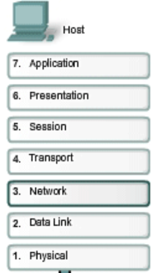
Encapsulation and De-capsulation
PDU
Data
Data
TH
Sg1
Segment
Sg3
Sg2
IH
Packet
FH
FT
Frame
FH
IH
TH
Sg1
FT
100101110010…
Bits
Communication media

Slide 21
TCP and UDP
TCP
Connection-oriented: 3 way handshake
Reliable: ACK, retransmission
Congestion control- Windowing
Uses sequence Numbers
UDP
Connection-less
Unreliable
Best effort
Segments may arrive out of order
A
B
A
SYN
B
SYN-ACK
3way hand shake
ACK
No ACK
No retransmission for lost data
Window size
1
3
2
x
ACK 4
4
5
x
6
ACK 5
retransmission
5
6

Slide 22
Port numbers
Used at the transport layer to identify application layer protocols
Ports <1024: well known port numbers
Port numbers
Application layer
FTP
Telnet
HTTP
DNS
TFTP
POP
21
23
80
53
69
110
Transport layer
TCP
UDP
6
17
IP
Protocol numbers

Slide 23
Cisco IOS
IOS-Internetwork Operating System
kernel of Cisco routers and switches that provides routing, switching & other internetworking functions
RAM- running configuration, lost if power is off
FLASH-storage for IOS
NVRAM- start-up configuration
ROM-stores router’s bootstrap, POST, ROMMON
Running configuration vs startup configuration

Slide 24
Cisco IOS (Cont’d)
POST: Diagnostic utility
Tests the hardware to verify that all components are operational and present
Checked at the first step of the boot sequence
Bootstrap:
Finds where IOS program is located, uses the value in config reg
Loads IOS image
Default being from flash memory, from TFTP also possible
ROMMON:
Used when bootstrap fails to load the IOS
provides a command-line environment used to perform some minimal configuration tasks (downloading IOS image using TFTP, recovering a lost password, etc)
CLI is used to access the IOS
.

Slide 25
Booting procedure of Cisco router
POST
passed?
Look for
IOS
Power on
a router
Yes
No
IOS found?
Load IOS
To RAM
Yes
No
Valid
Config in
flash?
Yes
Reload
Config to
RAM
ROMMON
No
Enter
Setup
mode
Exit

Slide 26
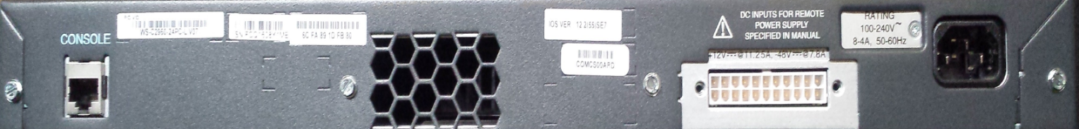
Cisco Switch parts
gig ports (SFP)
Port LEDs
Combo ports
Sys status LEDs
10/100 ports (RJ-45)
gig ports (RJ-45)
Front View of 2960 switch
Fan
Power input
Console cable
Rear View of 2960 switch

Slide 27
Command Line Interface (CLI)
Cisco IOS user interface
When start a session on the switch, we begin in user EXEC mode
Switch>
Switch>?
Exec commands:
enable Turn on privileged commands
exit Exit from the EXEC
logout Exit from the EXEC
ping Send echo messages
show Show running system information
telnet Open a telnet connection

Slide 28
CLI Cont’d
To have access to all commands: enter privileged EXEC mode
Switch>en?
enable
Switch>enable
Switch#
Global configuration mode: used to configure for parameters that apply the entire switch
Switch#configure terminal
Enter configuration commands, one per line. End with CNTL/Z.
Switch(config)#
e.g. configuring a hostname
Switch(config)#hostname Testswitch
Testswitch(config)#
Use tab to complete a command
Testswitch(config)#int<tab>

Slide 29
Interface configuration
Configuring an interface, from gloabal configuration mode, use interface <interface_type> <interface_no>
Testswitch(config)#interface fastEthernet 0/1
Testswitch(config-if)#
To exit from the interface configuration mode, use exit
Testswitch(config-if)#exit
Testswitch(config)#
e.g. to shut down fast ethernet 0/2, use
Testswitch(config)#interface fastEthernet 0/2
Testswitch(config-if)#shutdown
%LINK-5-CHANGED: Interface FastEthernet0/1, changed state to administratively down
Testswitch(config-if)#exit
Testswitch(config)#exit
Testswitch#

Slide 30
Verification
Use show commands (from privileged mode)
Testswitch#show running-config
Testswitch# sh startup-config
And look at the modifications we made: hostname and fa0/2
Testswitch#sh ip interface brief
Interfaces in brief
Testswitch#sh interfaces fastEthernet 0/2
Interface detailed information
Testswitch#sh history
Use ? After the show command to see the possible lists of commands
Testswitch#show ?

Slide 31
Password configuration
Enable password: access to privileged mode
Testswitch#conf t
Testswitch(config)#enable password ?
7 Specifies a HIDDEN password will follow
LINE The UNENCRYPTED (cleartext) 'enable' password
level Set exec level password
Testswitch(config)#enable password cisco
Now exit and login again
Enable secret: more secured
Testswitch(config)#enable secret cisco123
Now exit and login again

Slide 32
Line configuration
Configuring password for console port
Testswitch(config)#line console 0
Testswitch(config-line)#password 123
Testswitch(config-line)#login
Now logout and login again!

Slide 33
Saving Configuration
Unless saved, the running configuration will be lost if the switch boots (or if power goes off)
Contents of RAM copied to NVRAM
Testswitch# copy running-config startup-config
OR use write command from privileged mode
Testswitch#write

Slide 34
Undo a command
Use “no” command before the command we want to remove.
E.g. to enable the fa0/2 we all ready shut down, and hostname of the switch, use
Testswitch#
Testswitch#conf t
Testswitch(config)#int fastEthernet 0/2
Testswitch(config-if)#no shutdown
Testswitch(config-if)#exit
Testswitch(config)#no hostname
Switch(config)#

Slide 35
Traversing between modes
exit
exit
User
mode
enable
Privileged
mode
Conf t
Global config
mode
Int <type> <no>
Line <type> <no>
exit
exit
Interface
Config mode
Line config
mode

Slide 36
Reminders
Use the context-sensitive help (“?”) to list the possible commands
Do not forget to save your configuration
Keep Practicing and Practicing!!!!!!!

Slide 37

VLAN
To create smaller broadcast domains within a layer 2 network
Treated as its own subnet or broad cast domain
Router needed for hosts on different vlans to communicate
Enhance network security
Segment broadcast domain->efficiency
PC1
PC2
PC3
PC4

Slide 38
Configurations of vlans
VLANs are identified by a number from 1 to 4094
To configure VLAN,
Switch(config)#vlan <vlan_id>
Switch(config-vlan)#name <text>
E.g. Switch(config)#vlan 10
Switch(config-vlan)#name ICT
To delete a given VLAN
Switch(config)#no vlan <vlan_id>
e.g Switch(config)#no vlan 10

Slide 39
Layer 2 Interface Modes
Access: if a port belongs to a single VLAN
Trunk: a switch port that carries multiple vlans
E.g. A link between two switches
ISL: proprietary to Cisco, used on old versions
Dot1Q: standard for tagging vlans
switchport mode access: set to permanently access
switchport mode trunk: set to permanently trunk
switchport mode dynamic desirable: a port becomes trunk if the other end is trunk, deirable or auto
switchport mode dynamic auto: a port becomes trunk if the other end is trunk, deirable

Slide 40
Cont’d
Switch(config)# interface gigabitethernet0/1
Switch(config-if)# switchport mode access
Switch(config-if)# switchport access vlan 10
Switch(config)# interface gigabitethernet0/2
Switch(config-if)# switchport mode trunk
Switch(config-if)# switchport trunk allowed vlan 1,10

Slide 41
VTP
To manage all configured VLANs
Additions, deletions of vlans made on one central device and propagate through VTP
Three mode: Server, Client, Transparent
Uses configuration revision number to update vlan database

Slide 42
Spanning Tree Protocol
Switches forward broadcast packets out all ports
Redundant connections are also necessary
Sw1
Sw2
Sw3
broadcast
PC1
Solution: STP to remove redundant links at layer2

Slide 43
STP (Cont’d)
Use BPDUs to discover loops and select the root bridge
All switches find the best path to root bridge and block all redundant links
Bridge ID
Default priority-32768
The lower bridge ID the better
Priority
MAC address

Slide 44
Election of root bridge
1. Elect the root bridge
The switch with lower brige ID wins
2. Switch finds lowest cost path the root bridge
Link costs
100Mbps:19
1Gbps:4
Three port roles
Root port: used to reach the root bridge
Designated port: forwarding port: 1 per link
Blocking: blocked by STP

Slide 45
Example 1
All links are fast ethernet
Switch A
32768:aaaa.aaaa.aaaa
Switch B
Switch C
32768:bbbb.bbbb.bbbb
32768:cccc.cccc.cccc
Q: Determine the port to be blocked.

Slide 46
Example 2
Switch A
All links have equal cost
4096:9999.9999.9999
32768:0101.0101.0101
Switch B
Switch C
8192:cccc.cccc.cccc
Switch D
32768:dddd.dddd.dddd
Q: Determine the port to be blocked.

Slide 47
Example 3
32768:5F30:FEEE.3D50
Switch A
Fa0/1
Fa0/2
Fa0/10
Fa0/8
Switch B
32768:5F30:EEEE.3D21
Q: Determine the port to be blocked.

Slide 48
Configuration of STP
Cisco switches run PVST- 1 root bridge for each VLAN
To configure spanning tree
Switch(config)#spanning-tree mode pvst
To make a switch a root bridge
Switch(config)#spanning-tree vlan 1 root primary
To change a priority
Switch(config)#spanning-tree vlan 1 priority 4096

Slide 49
Port states
Listening: switch sends/receives BPDU
Learning: learns MAC address
Forwarding: sending traffic
Blocking: stays in this state before moving to listening state

Slide 50
Access Control List (ACL)
filters network traffic by controlling whether packets are forwarded or blocked at the router’s interface
List of permit and deny statements
Used for:
Access control
Filtering traffic
Rules:
List is read from top to bottom and stops at the first match
Implicit deny at the bottom
Applied to an interface inbound or outbound

Slide 51
ACL (cont’d)
Increase network performance
provide for security
which traffic is blocked
which traffic is forwarded
Uses src/dst addresses, protocol types (TCP, UDP or IP), port numbers to classify network traffic

Slide 52
Types
Standard ACL:
Matches based on source address
Lower processor utilization
Extended ACL:
Matches based source/destination address, protocol, source/destination port numbers
Higher processor utilization
Relatively complex syntax

Slide 53
Configuration
Create the ACL
Apply to an interface
inbound or outbound
Verify configuration
Use show access-lists

Slide 54
Configuration (cont’d)
Configuring standard access list
Router(config)#access-list <1-99> <permit/deny> <src address> <wild card>
E.g:
R1(config)#access-list 1 permit 192.168.1.0 0.0.0.255
Access list 1 when applied will allow the network 192.168.1.0/24
R1(config)#access-list 1 deny host 192.168.1.1
Will deny only 192.168.1.1 ip address
R1(config)#access-list 1 deny any
Will deny any network

Slide 55
Configuration (cont’d)
Configuring Standard access control list
access-list <100-199> <permit|deny> <protocol> <source-address> <source-wildcard-mask> <destination-address> <destination-wildcard-mask> <eq | lt| gt> <port-number>
E.g.
access-list 101 permit ip 192.168.10.0 0.0.0.255 67.10.10.5 0.0.0.0
Permits all ip connections from 192.168.10.0 network to a host 67.10.10.5
access-list 101 deny tcp 192.168.10.10 0.0.0.0 67.10.10.5 0.0.0.0 eq 80
Denies web access from host 192.168.10.10 to web server of 67.10.10.5

Slide 56
Applying ACL
Either inbound or outbound
Use ip access-group <acl-number> <in | out>
E.g.
Int fa 0/0
Ip access-group 1 in→ applies acl number 1 on fa0/0 for inbound traffic
Int fa 0/1
Ip access-group 1 out→ applies acl 1 on fa 0/1 for out bound traffic

Slide 57
Network Address Translation(NAT)
IPV4 address depletion: Private and Public
NAT is a translation b/n private and gloabal IP addresses
NAT has made IPV4 stay on the protocol list
Allows for multiple devices to share an IP address (global)
It also hides private IP addresses: enhances security

Slide 58
Types of NAT
Static: one-to-one mapping between local and global addresses
Usually for servers accessible from the Internet
Dynamic: translate private IP address to a pool of global IP addresses
Overload: maps multiple private IP addresses to a single global IP address
Most popular
Uses port Nos (Port Adress Translation or PAT)

Slide 59
Configuration
Interfaces: the router/firewall needs to have at least two interfaces
Inside: connects to our internal network
Command used: ip nat inside
Outside: connects to the external/Internet network
Command used: ip nat outside
Static NAT:
ip nat inside source static <private_IP><global_IP>
E.g:
ip nat inside source static 10.128.5.16 213.55.94.36

Slide 60
Configuration (Cont’d)
Dynamic ACL:
First select the private IP address to be translated
Access-list 1 permit 10.128.0.0 0.0.255.255
Create the pool of global IP addresses
Ip nat pool <pool_name> <start_IP> <end-IP> netmask <subnet_mask>
Ip nat pool mypool 97.10.50.1 97.10.50.30 netmak 255.255.255.224
To translate
ip nat inside source list <acl_no> pool <pool_name>
Ip nat inside source list 1 pool mypool

Slide 61
Configuration (Cont’d)
PAT (overloading):
First select the private IP address to be translated
Access-list 1 permit 10.128.0.0 0.0.255.255
Overload it to outside interface
ip nat inside source list 1 interface <interface_type> <interface_number> overload
OR Overload it to one global ip address
For verification
sh ip nat translations

Slide 62
Introducing Routing
Routers must learn the direction to remote networks in order to forward packets.
There are 2 ways to learn this information:
Dynamic Routing
Static Routing
Routers use the routing process to
Forward packets toward the destination network
Decisions based upon the destination IP address
Dynamic routing
Routers learn information from other routers
Scalable – each change learned from another router
Static routing

Slide 63
Static Routing
Configured manually by the network administrator
Add and remove static routes when topology changes
Static Route Operations are divided into three parts:
Network administrator configures the route
Router installs the route in the routing table
Packets are routed using the static route
Command
Router#config terminal
Router(config)#ip route 172.16.1.0 255.255.255.0 s0
Router(config)#ip route destination subnet outgoing

Slide 64
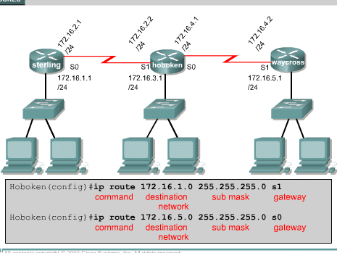
Static Routes using Outgoing Interface
Specifies
Outgoing
Interface

Slide 65
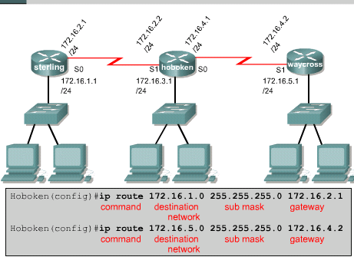
Static Route Using Next Hop
Specifies
Next Hop

Slide 66
The Difference between the 2 options is
The Difference between the 2 options is
Administrative distance assigned to the route
Administrative distance
Optional
Measures the reliability of the route (0 – 255)
The lower the number the more reliable the route
Set to 1 for next hop
Set to 0 for outgoing interface
Routers choose the route with the lowest administrative distance

Slide 67
To set a static route that is not 1 or 0
ip route 192.21.121.0 255.255.255.0 192.21.122.1 130
Static routes
Can be used as a backup if dynamic route fails
Must have higher admin no. to dynamic route

Slide 68
Configuring a Default Route
Default routes
Route packets with destinations that do not match any of the other routes in the routing table
Often used for
internet-bound traffic
Non-directly connected networks
Special form of a static route
ip route 0.0.0.0 0.0.0.0 [next-hop-address or outgoing if]
Example ip route 0.0.0.0 0.0.0.0 s0

Slide 69
Verifying static route configuration
show running-config
Views the active configuration in RAM to verify that the static route was entered correctly
show ip route
Make sure that the static route is present in the routing table
Ping <ip address>
check a connection
Traceroute <ip address>
Shows the path to the ip address
Can be used to identify where the connection fails

Slide 70


